Slide 1
CEIS101 IoT: Internet of Things Final Project
Created by: Jeremy Duncan

Slide 2
Introduction
In this project I will be demonstrating fundamental concepts of the “Internet of things” (IoT) with Arduino technology by creating an automated home security system.

Slide 3
Concepts Covered
Section 1: prototyping
Section 2: Arduino Components
Section 3: Door Alarm
Section 4: Detecting distance
Section 5: Automated Lights

Slide 4
SECTION 1
Prototyping:
In section one of my project I am:
designing a digital prototype in a virtual enviroment called tinker cad.

Slide 5
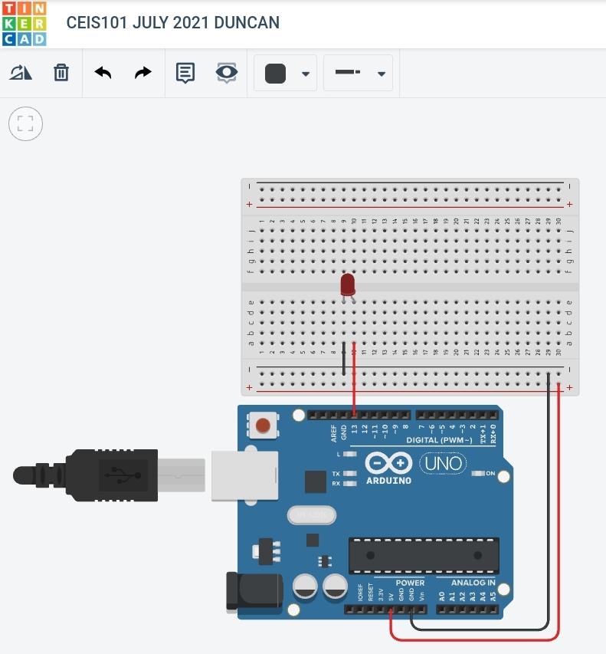
Section 1: Prototyping
First I created a digital prototype to start planning out my circuit by using Tinker CAD.
This is a simple demonstration of making a red LED blink on and off.

Slide 6
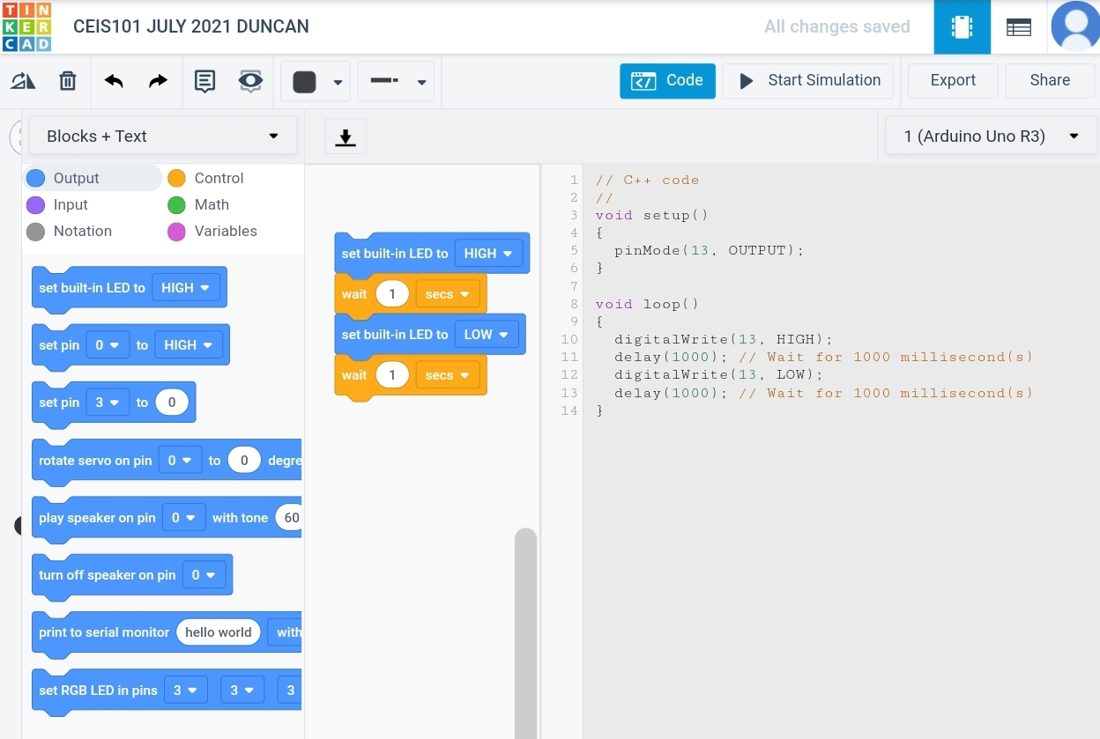
Section 1: Prototyping
I also used Tinker CAD to create this basic code to operate my prototype. In this example I’m using a form of block coding they offer on their website.

Slide 7
SECTION 2
Arduino components:
In section two of my project I am:
GATHERING THE aRDUINO KIT.
SETTING UP MY WORKSPACE
Using the previous digital prototype as a reference to Assemble the physical prototype.

Slide 8
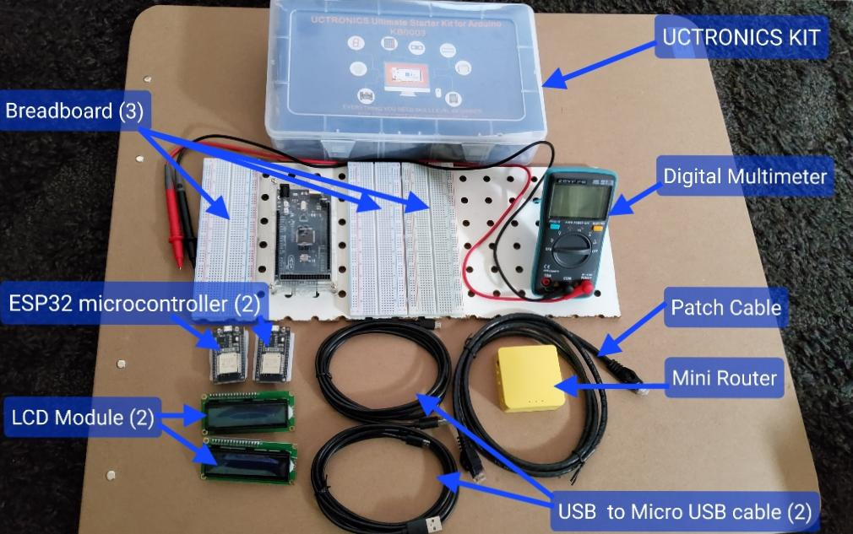
Section 2: Arduino Components
This is the basic IoT starter kit that is made available for CEIS101.

Slide 9
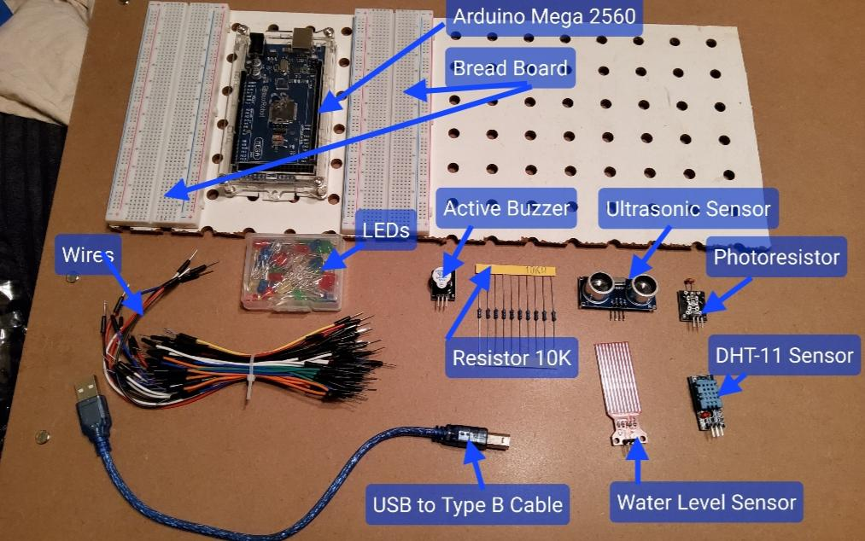
Section 2: Arduino Components
Here are a few of the components, and accessories that are inside the kit.

Slide 10
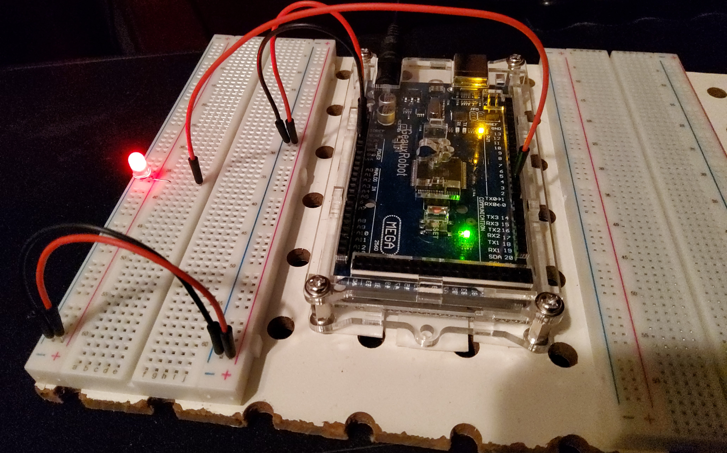
Section 2: Arduino Components
I referenced the digital prototype I created in Tinker CAD, and assembled the physical parts here as shown.

Slide 11
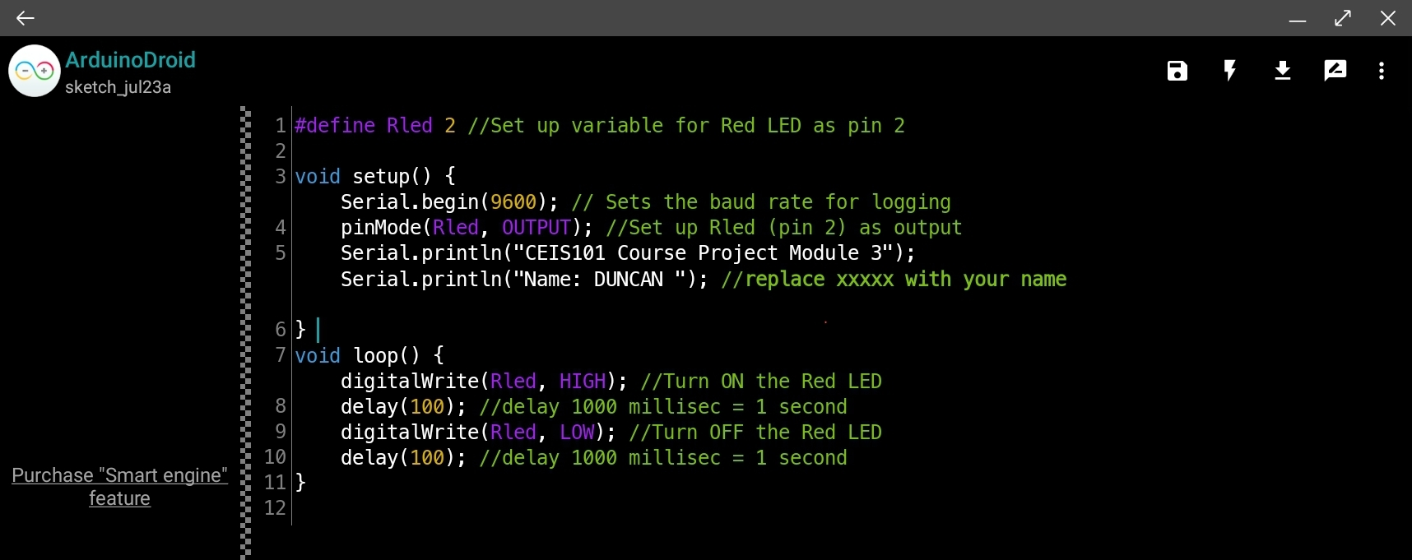
Section 2: Arduino Components
I used an Android App called “ArduinoDroid” to upload the code I needed to make the red LED blink on and off. This can be accomplished using the native Arduino IDE too.
This is the C++ code I used for this example.

Slide 12
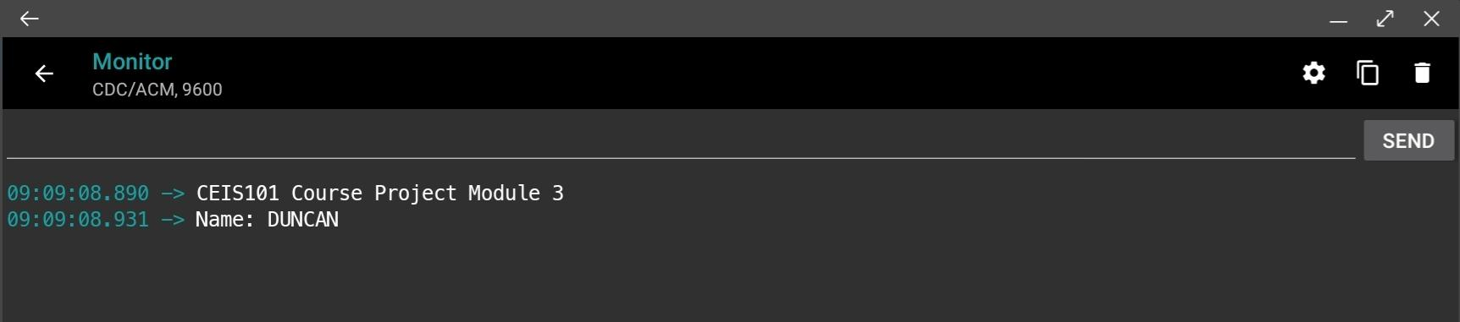
Section 2: Arduino Components
Inside the App while the board is connected, I can view the output of the Arduino board by viewing the serial data. Below you can see the message from the Arduino serial data.

Slide 13
SECTION 3
door alarm:
In section three of my project I am:
CREATING A PROTOTYPE DOOR ALARM WITH THE ARDUINO MEGA 2560.
PROGRAMMING THE ARDUINO MEGA 2560 WITH THE ARDUINO IDE.
TESTING THE PROTOTYPE DOOR ALARM.

Slide 14
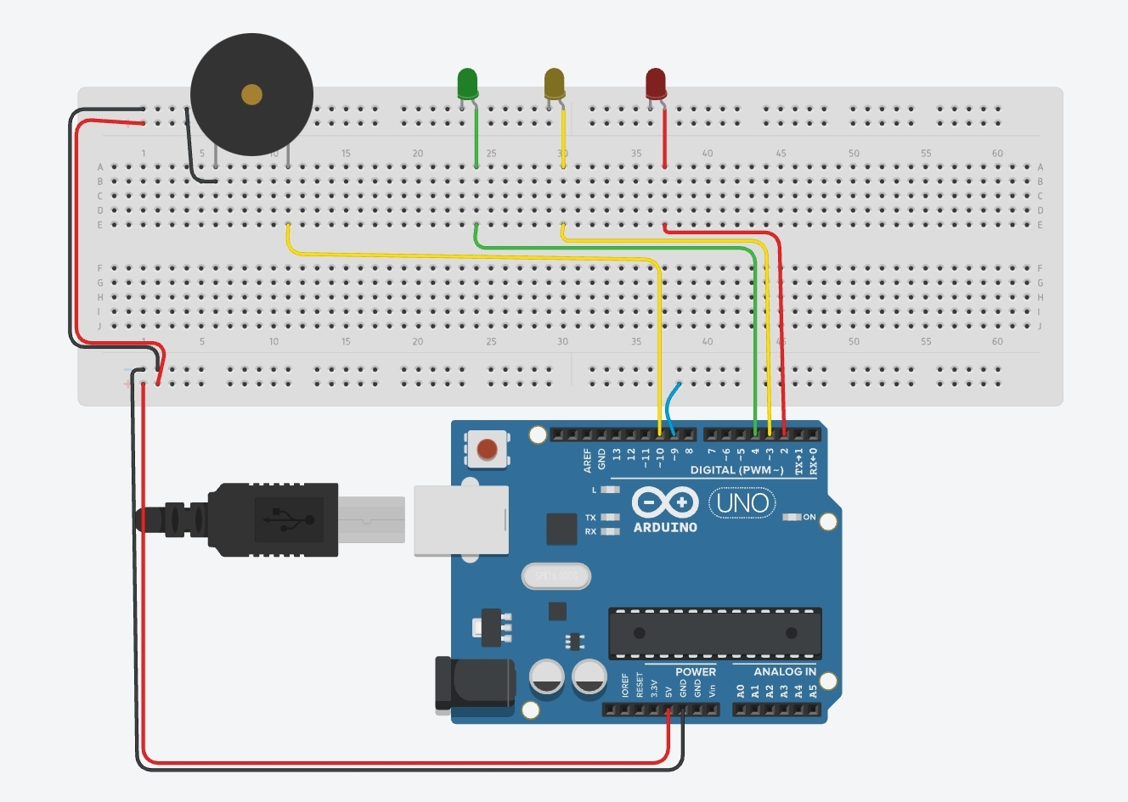
Section 3: Door Alarm
In this section I am adding a few more LEDs, an active buzzer, and a trip wire to simulate a door being opened.

Slide 15
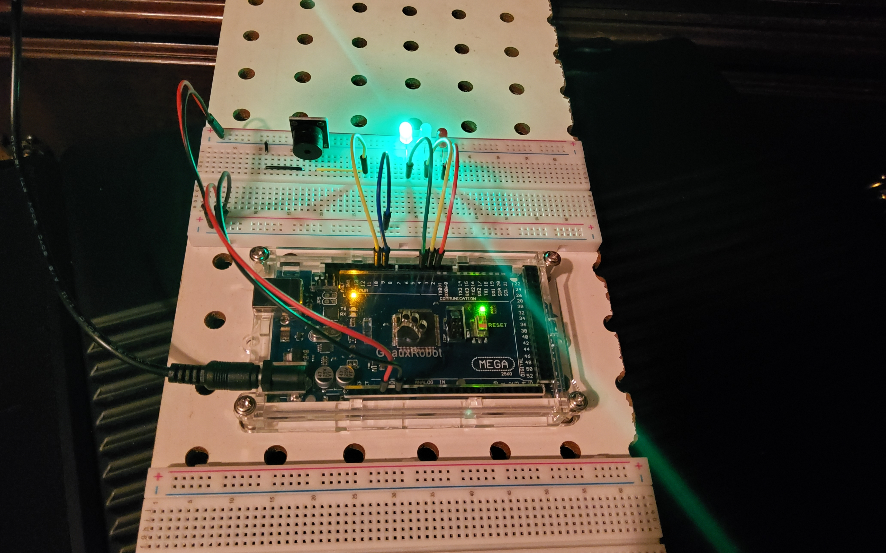
Section 3: Door Alarm
When the trip wire is connected, the LED will stay green.

Slide 16
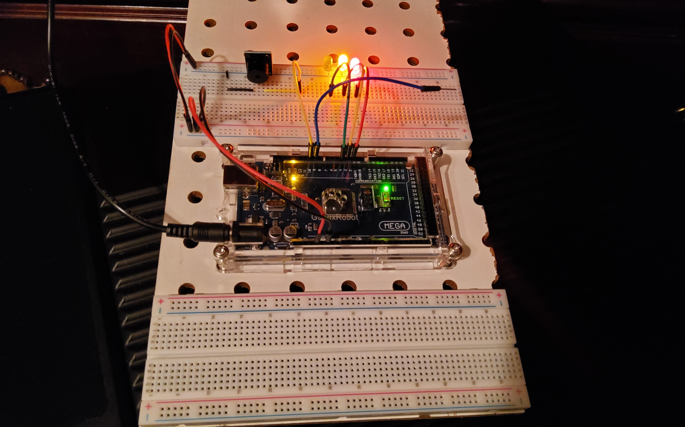
Section 3: Door Alarm
When the trip wire has been removed from the board, it will turn off the green LED, light up the red and yellow LED, and sound the alarm through the buzzer that’s now installed.

Slide 17
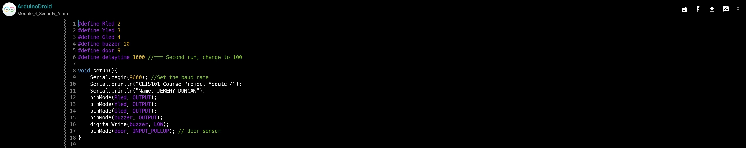
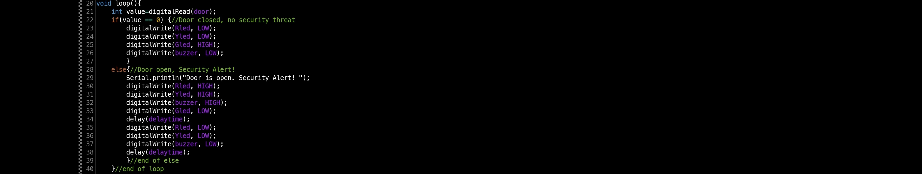
Section 3: Door Alarm
This is the C++ code that was used.

Slide 18
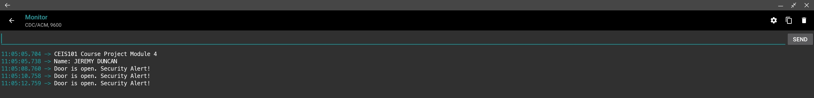
Section 3: Door Alarm
Here is the serial output from the arduino Mega 2560 when the alarm has be activated.

Slide 19
SECTION 4
detecting distance:
In section four of my project I am:
ADDING A SONAR DISTANCE SENSOR TO THE PROTOTYPE HOME ALARM SYSTEM.
PROGRAMMING THE ARDUINO MEGA 2560 WITH THE ARDUINO IDE.
TESTING THE SONAR DISTANCE SENSOR.
VIEWING RAW DATA FROM SENSORS.
PLOTTING RAW DATA OBTAINED INTO a VIEWABLE CHART.

Slide 20
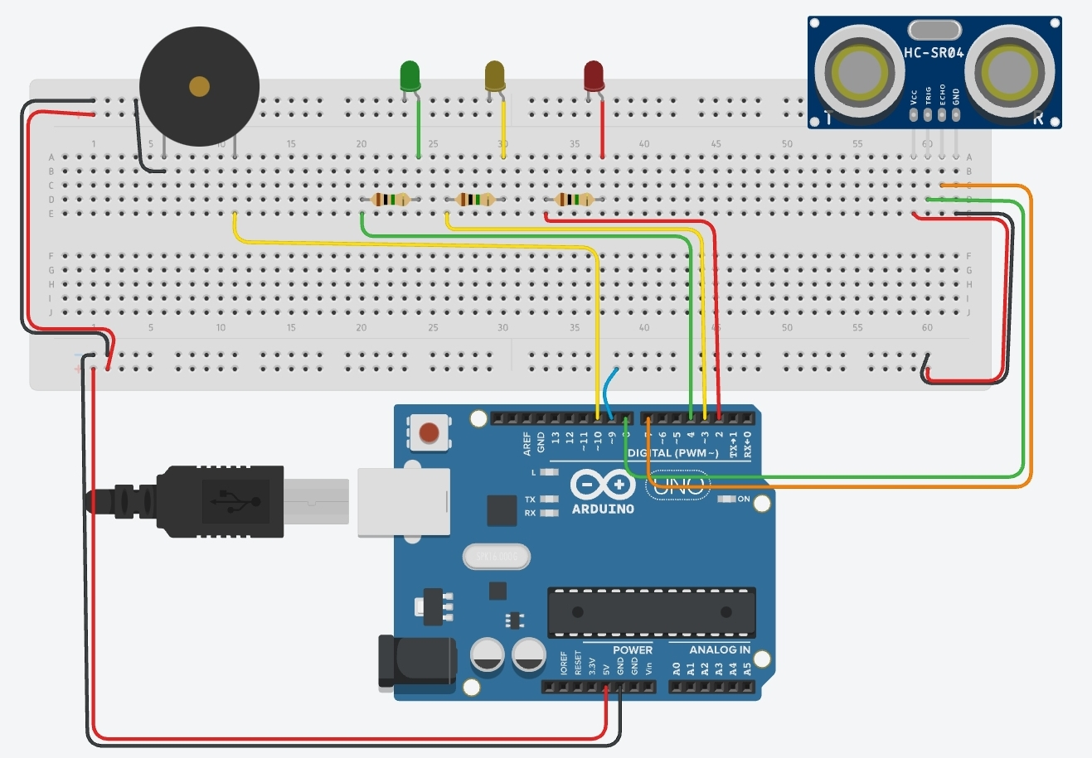
Section 4: Detecting Distance
In this section I am adding a sonar sensor to detect when someone is approaching the home security system.

Slide 21
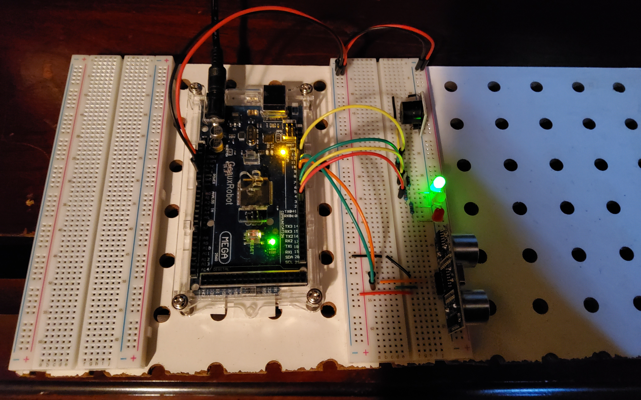
Section 4: Detecting Distance
When there is nothing near the security system, the LED stays green.

Slide 22
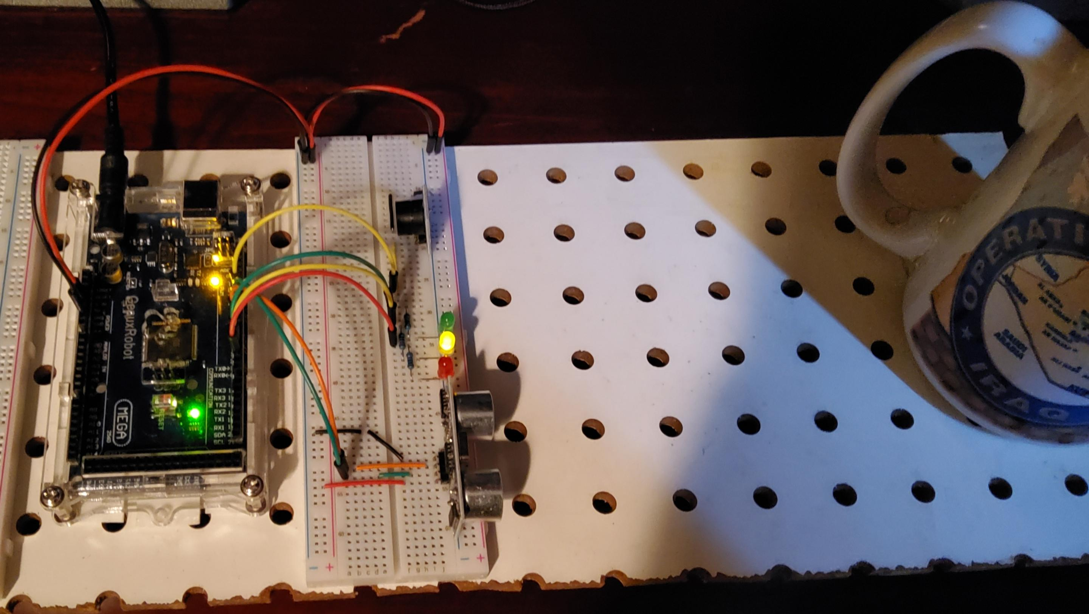
Section 4: Detecting Distance
When something starts to approach, the green LED turns off, and the yellow LED turns on.
The buzzer also starts to beep to notify a proximity alert.

Slide 23
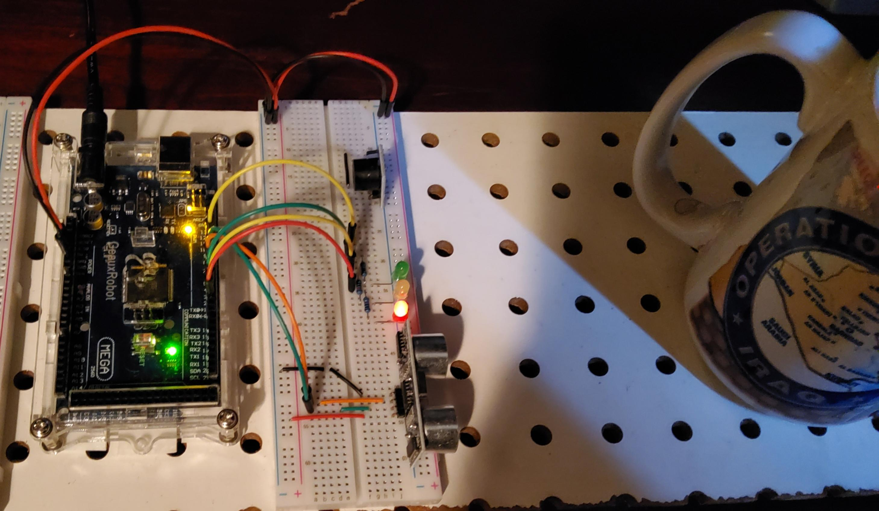
Section 4: Detecting Distance
When an obeject gets even closer, the yellow LED turns off, and the red LED turns on.
The buzzer also starts to beep faster to notify an even closer proximity alert.

Slide 24
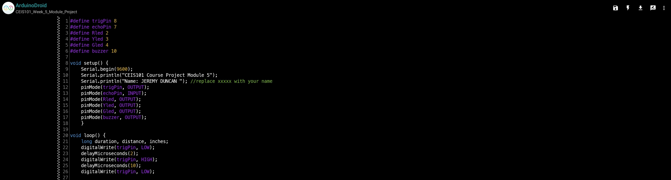
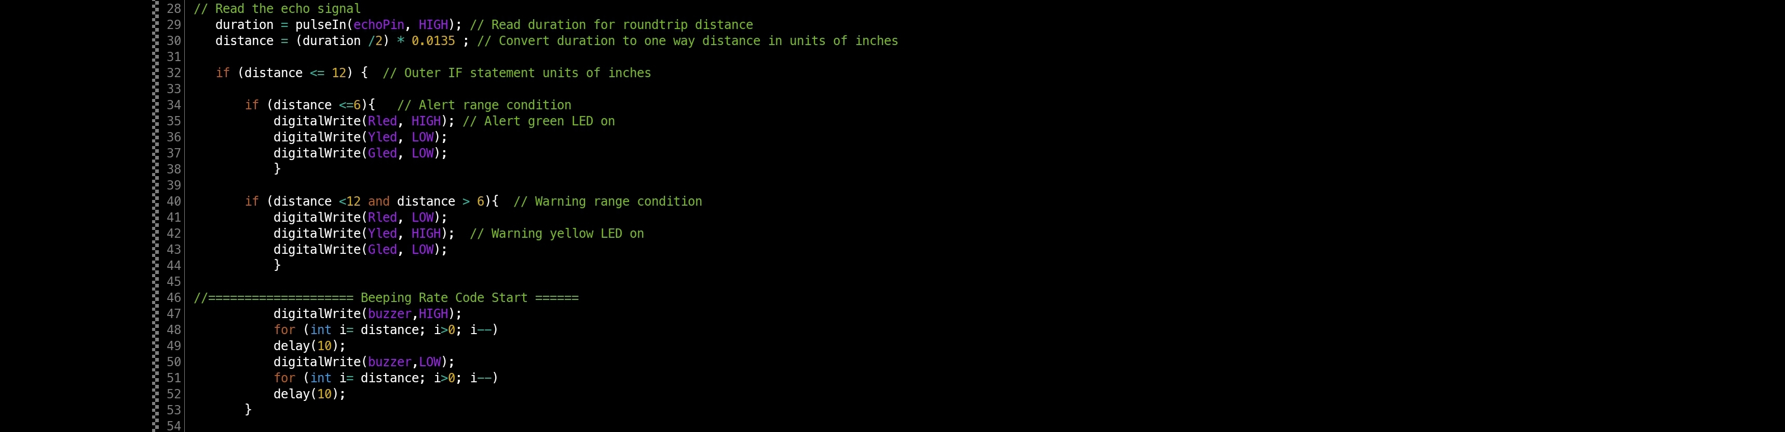

Section 4: Detecting Distance
This is the C++ code used for this section.

Slide 25
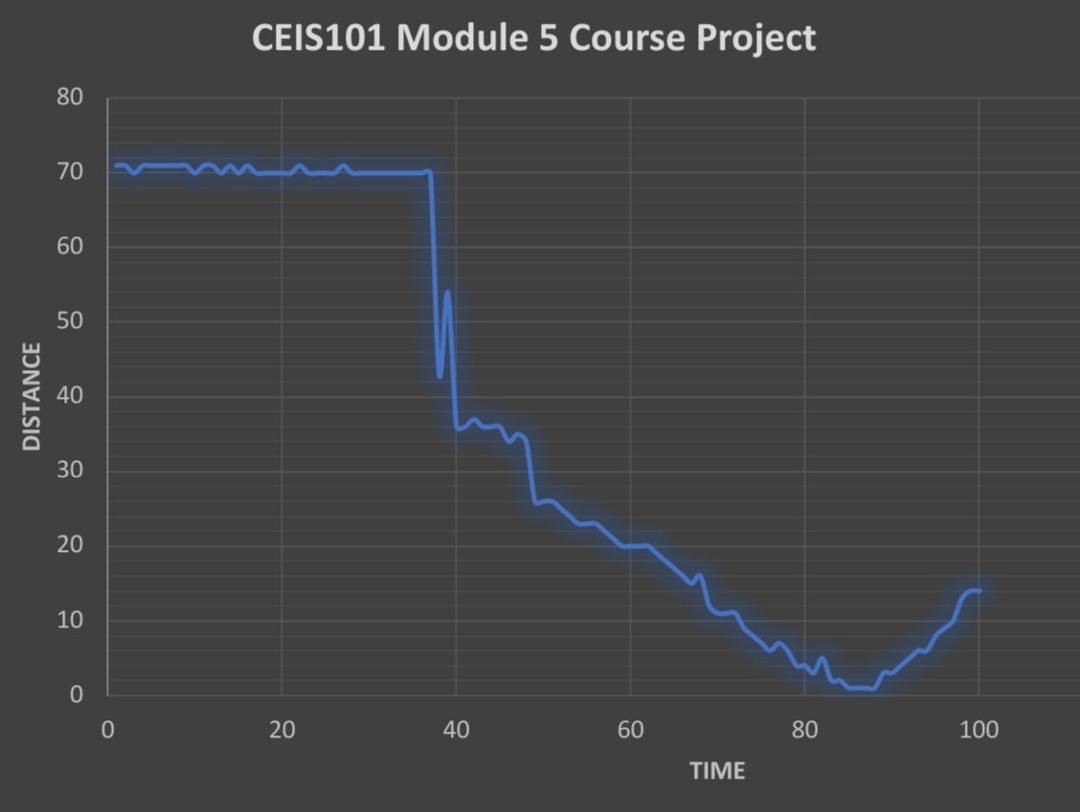
Section 4: Detecting Distance
I took the raw data provided from the Arduino from the sonar sensor and created a chart.
You can see the gradual change in distance from the previous slides.

Slide 26
SECTION 5
automated lights:
In section five of my project I am:
Adding a photoresistor to my home security system to create automated lights.
PROGRAMMING THE ARDUINO MEGA 2560 WITH THE ARDUINO IDE.
TESTING THE photoresistor.
VIEWING RAW DATA FROM SENSORS.

Slide 27
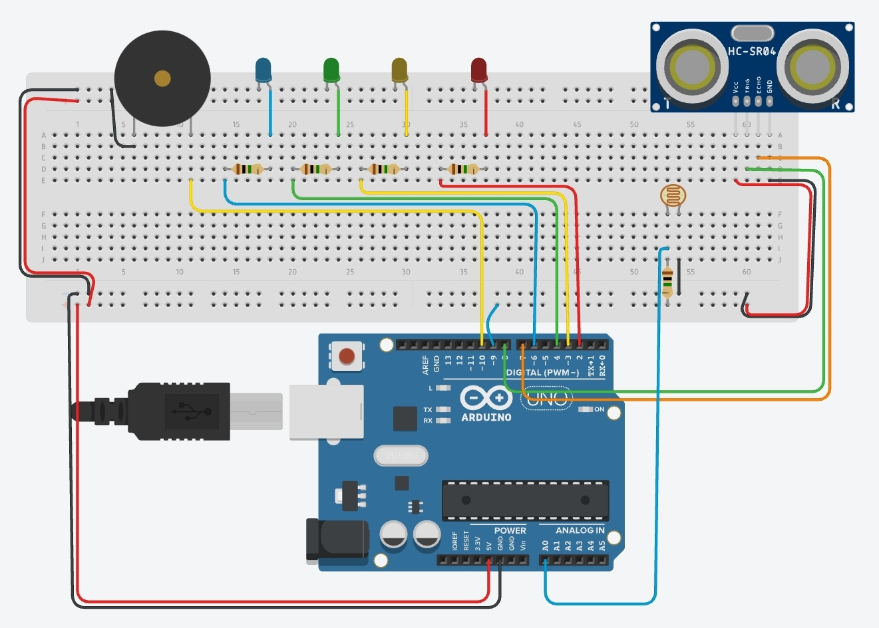
Section 5: Automated Lights
In this section I am adding a photoresistor to detect when it gets dark so the home security system turns on a light.

Slide 28
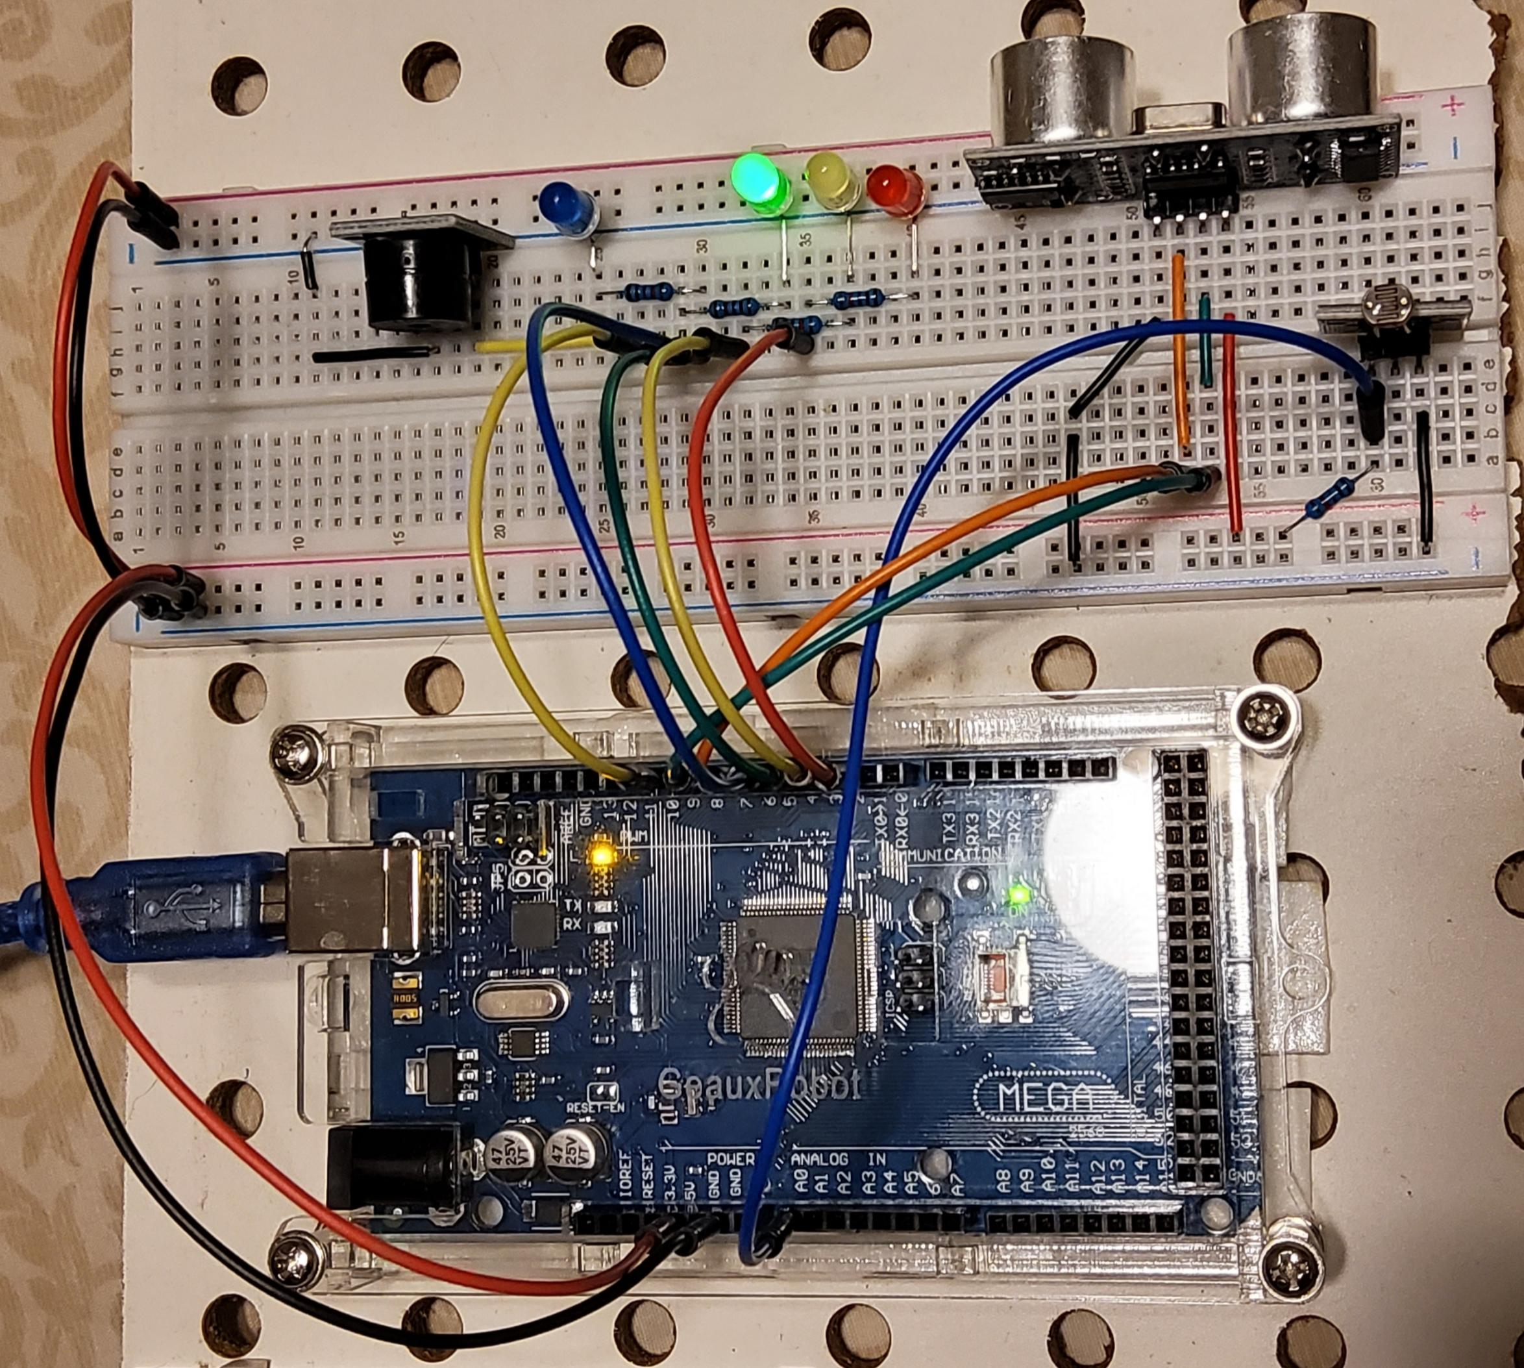
Section 5: Automated Lights
When the photoresistor detects light, the blue LED shuts off.

Slide 29
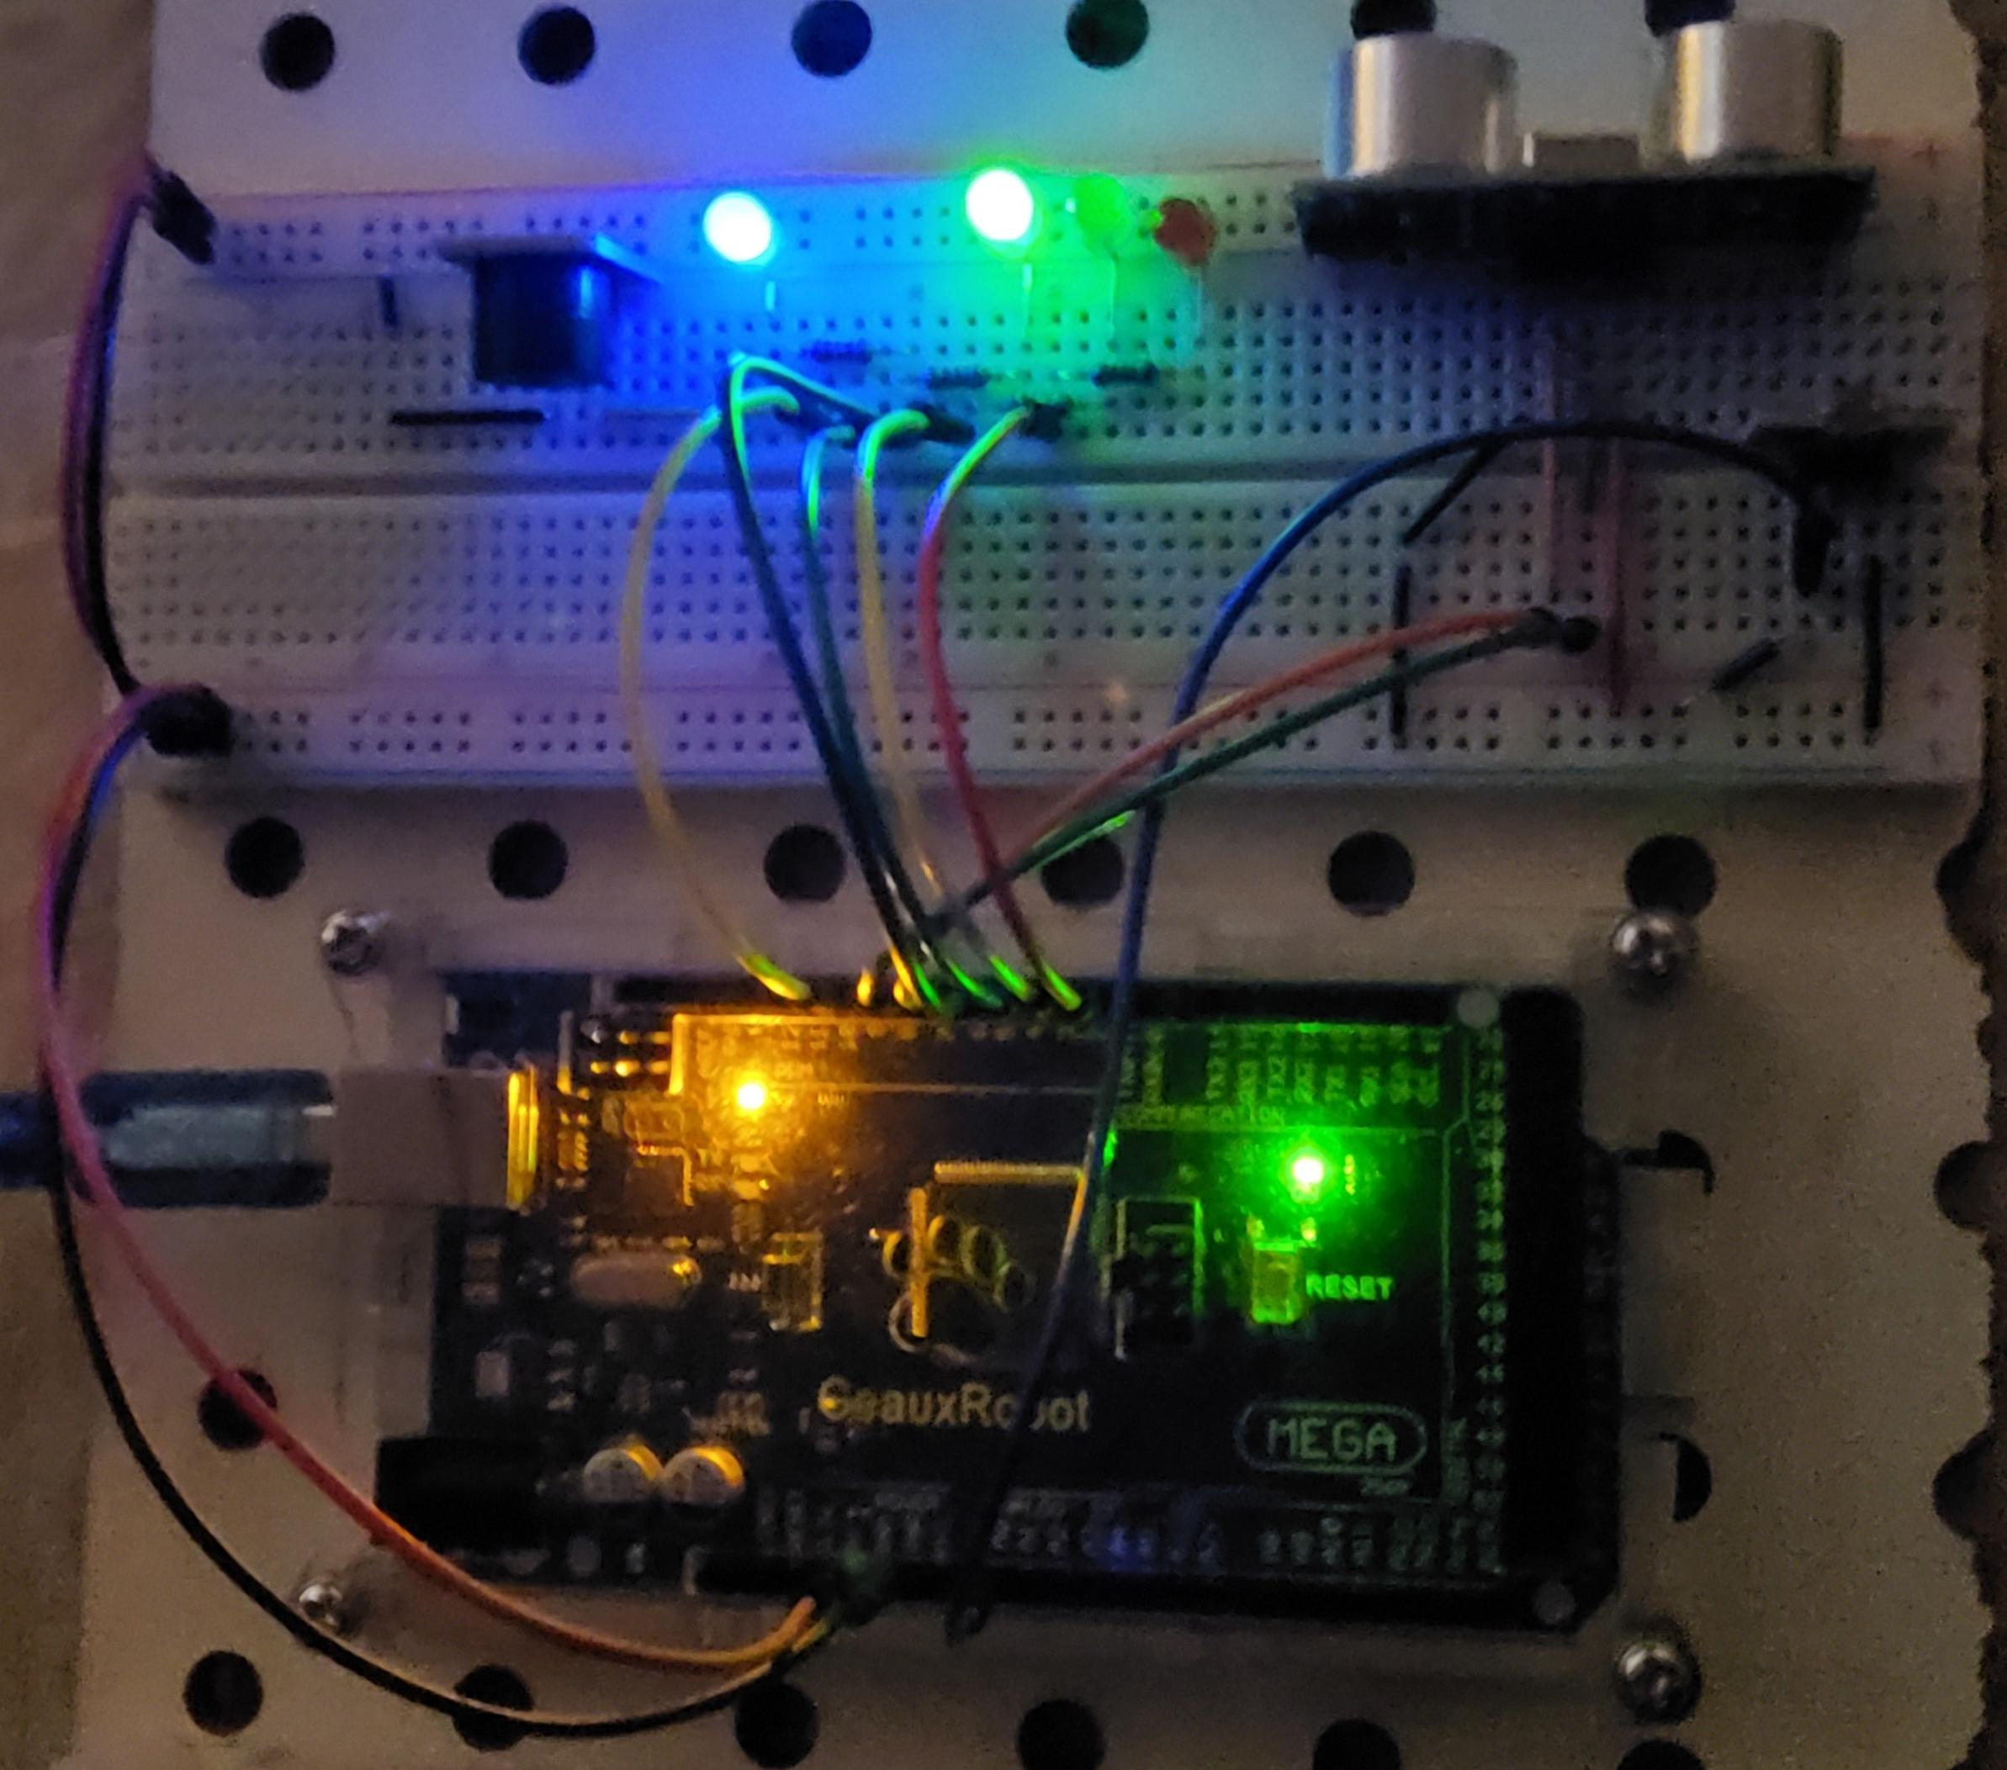
Section 5: Automated Lights
When the photoresister does not detect light, it triggers the blue LED to turn on.

Slide 30
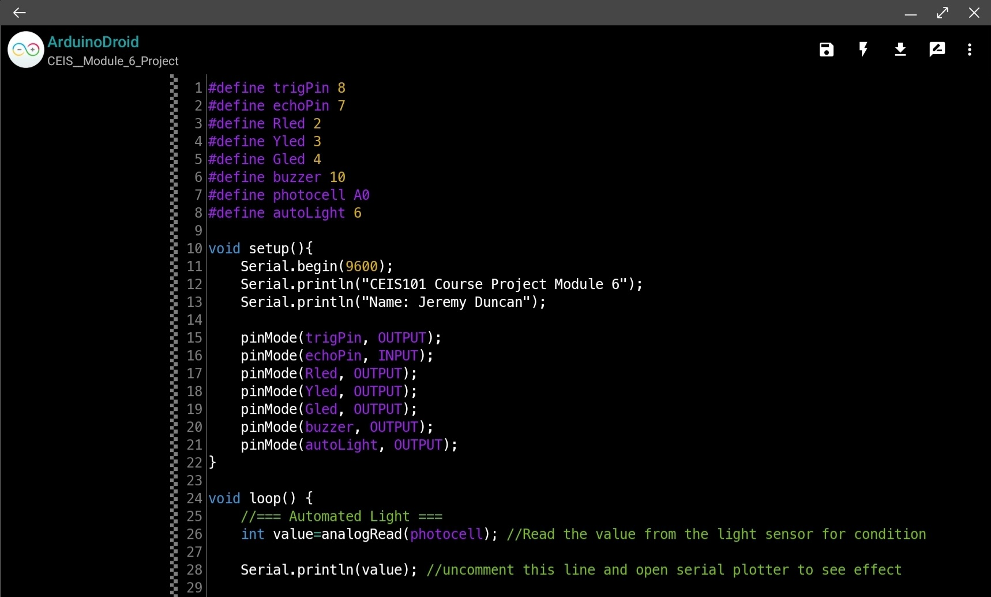
Section 5: Automated Lights
Once again I modify the C++ code so the new sensor functions correctly.

Slide 31
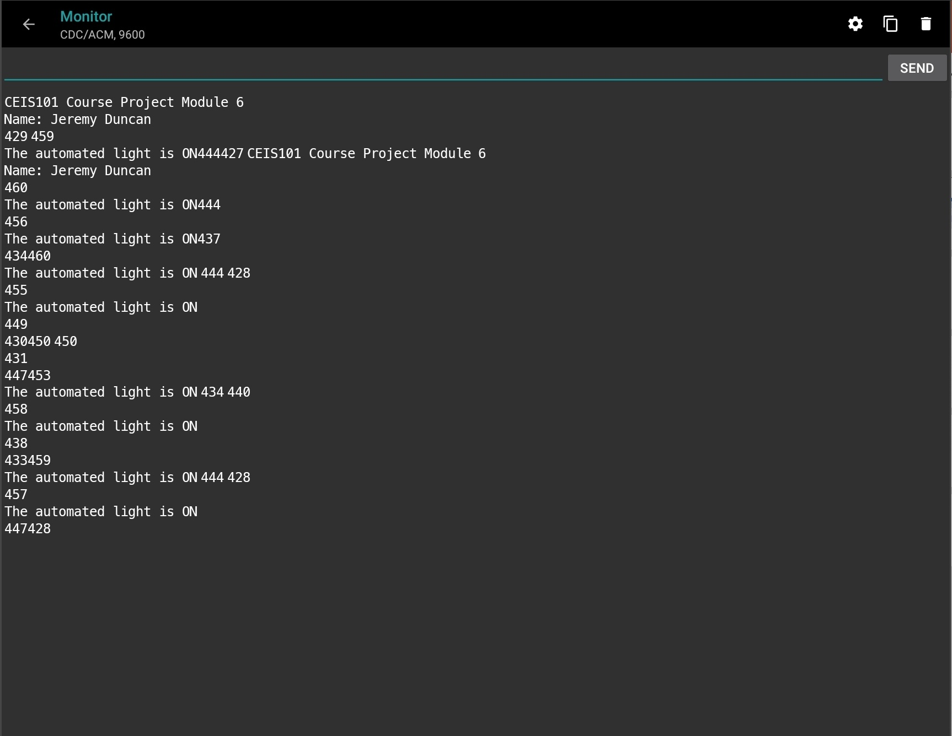
Section 5: Automated Lights
Inside the App while the board is connected, I can view the output of the Arduino board by viewing the serial data. Below you can see the message from the Arduino serial data, as well as the photoresister data.

Slide 32
Project CHallenges
Section 5: Automated Lights
since I did not have access to a windows enviroment, One of the challenges I faced was doing this project entirely from an android operating system on my Samsung Galaxy Tab s7+. I was able to overcome this obstable by using the App “ArduinoDroid” as a work around for the Arduino IDE.

Slide 33
Career Skills obtained
Section 5: Automated Lights
FAMILIARITY WITH aRDUINO components and how they function.
C ++ coding experience.
Working in virtual enviroments.
prototyping
EXPERIENCE WITH ELECTRONICS AND TROUBLESHOOTING.
Data analysis

Slide 34
Conclusion
This was a very interesting journey in creating an automated home security system using Arduino technolgy. I am very fascinated by the many possible applications of IoT in today’s world. I’m looking forward to discover many other uses for what I can create with Arduino and other IoT hardware.

Slide 35
REFERENCES
https://www.arduino.cc/
https://store.arduino.cc/usa/mega-2560-r3
https://www.arduino.cc/en/software
https://www.tinkercad.com/learn/circuits/learning

